Slide 1
Creating a React Web App
Creating a simple app
Creating many elements
Data-driven UIs

Slide 2
Section 1: Creating a Simple App
Scenario
Defining an HTML target element
Importing React artifacts
The virtual DOM
Creating React elements
Rendering React elements
Aside: Using an import map for simplicity

Slide 3
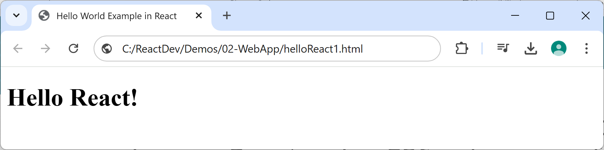
Scenario
In this chapter we show how to create simple React apps in pure React, using ES6++ language features
See the Demos/02-WebApp folder
The first example we'll look at is helloReact1.html
This is a minimalistic "Hello World" React app ☺

Slide 4
Defining an HTML Target Element
A React web app has a single top-level HTML element into which React will render the UI
You typically define it like this
Give it a suitable id
You'll refer to this id when you render content (see later)
<div id="root"></div>

Slide 5
Importing React Artifacts
To use React in a web page, you need 2 imports:
React
This class enables you to create element objects
createRoot
This function creates a root, into which you render elements
<script type="module">
import React from "https://esm.sh/react"
import { createRoot } from "https://esm.sh/react-dom/client"
… code to create and render elements (see following slides) …
</script>

Slide 6
The Virtual DOM
In a web app, you can manipulate elements using DOM
Create elements, append child element, etc.
Low-level, tedious, and quite slow rendering
React introduces the concept of the virtual DOM
You create React elements (lightweight JS objects)
You manipulate these lightweight JS objects
React renders the appropriate HTML very efficiently

Slide 7
Creating React Elements
You can create a React element programmatically by calling React.createElement()
1st argument specifies the type of element to create
2nd argument specifies the element's properties
3rd argument specifies the element's children
const obj = React.createElement(
'h1',
{id: 'my-msg', 'title': 'This is my message'},
'Hello React!'
)

Slide 8
Rendering React Elements
Render your top-level React element into a target location on the web page, as follows:
createRoot()
Creates a root, which identifies where content is to be rendered
root.render()
Tells React what content to render
const root = createRoot(document.getElementById('root'))
root.render(obj)

Slide 9
Aside: Using an Import Map for Simplicity
It's common practice to define an import map
Simplifies the import statements in your code
<script type="importmap">
{
"imports": {
"react": "https://esm.sh/react",
"react-dom/client": "https://esm.sh/react-dom/client"
}
}
</script>
<script type="module">
import React from "react"
import { createRoot } from "react-dom/client"
…
</script>
helloReact2.html

Slide 10
Section 2: Creating Many Elements
Overview
Hierarchy of React elements
View the page in the browser
View the virtual DOM

Slide 11
Overview
In this section we'll see how to create a more ambitious virtual DOM tree, containing nested React elements
Then we'll render the root React element to the DOM
Actually that's an important point…
You only ever render the root React element to the DOM

Slide 12
Hierarchy of React Elements
createElement() can take a variadic list of child elements, so you can create a hierarchy of elements
For an example, see multipleElements.html
const ul = React.createElement('ul', null,
React.createElement('li', null, 'Item1'),
React.createElement('li', null, 'Item2'),
React.createElement('li', null, 'Item3'))

Slide 13
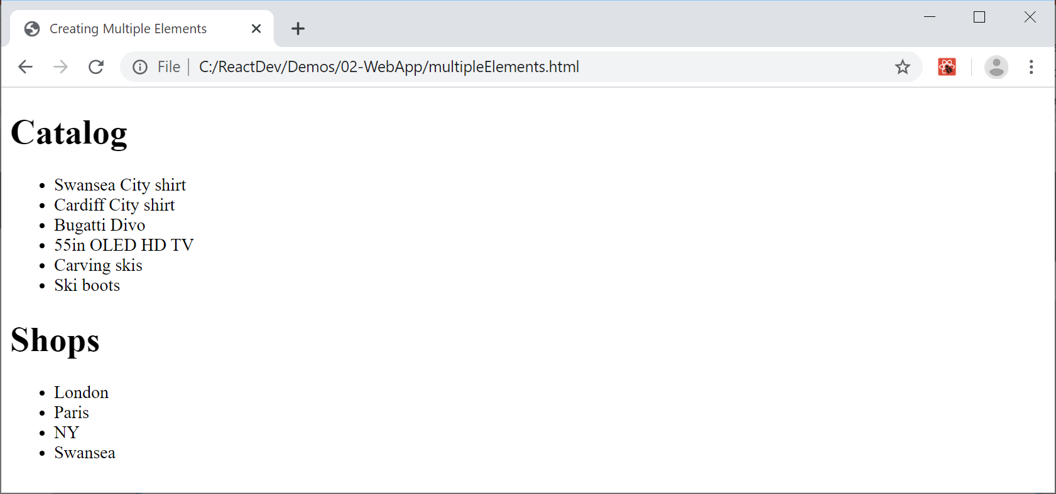
View the Page in the Browser

Slide 14
View the Virtual DOM (1 of 2)
To view components in the virtual DOM, e.g. using React Developer Tools in Chrome:
Show the DevTools window (F12)
Click the Components tab
In the Search window, click the Settings icon
In the popup window, select the Components tab
Deselect the "Hide components where" option
You should now see a list of the components

Slide 15
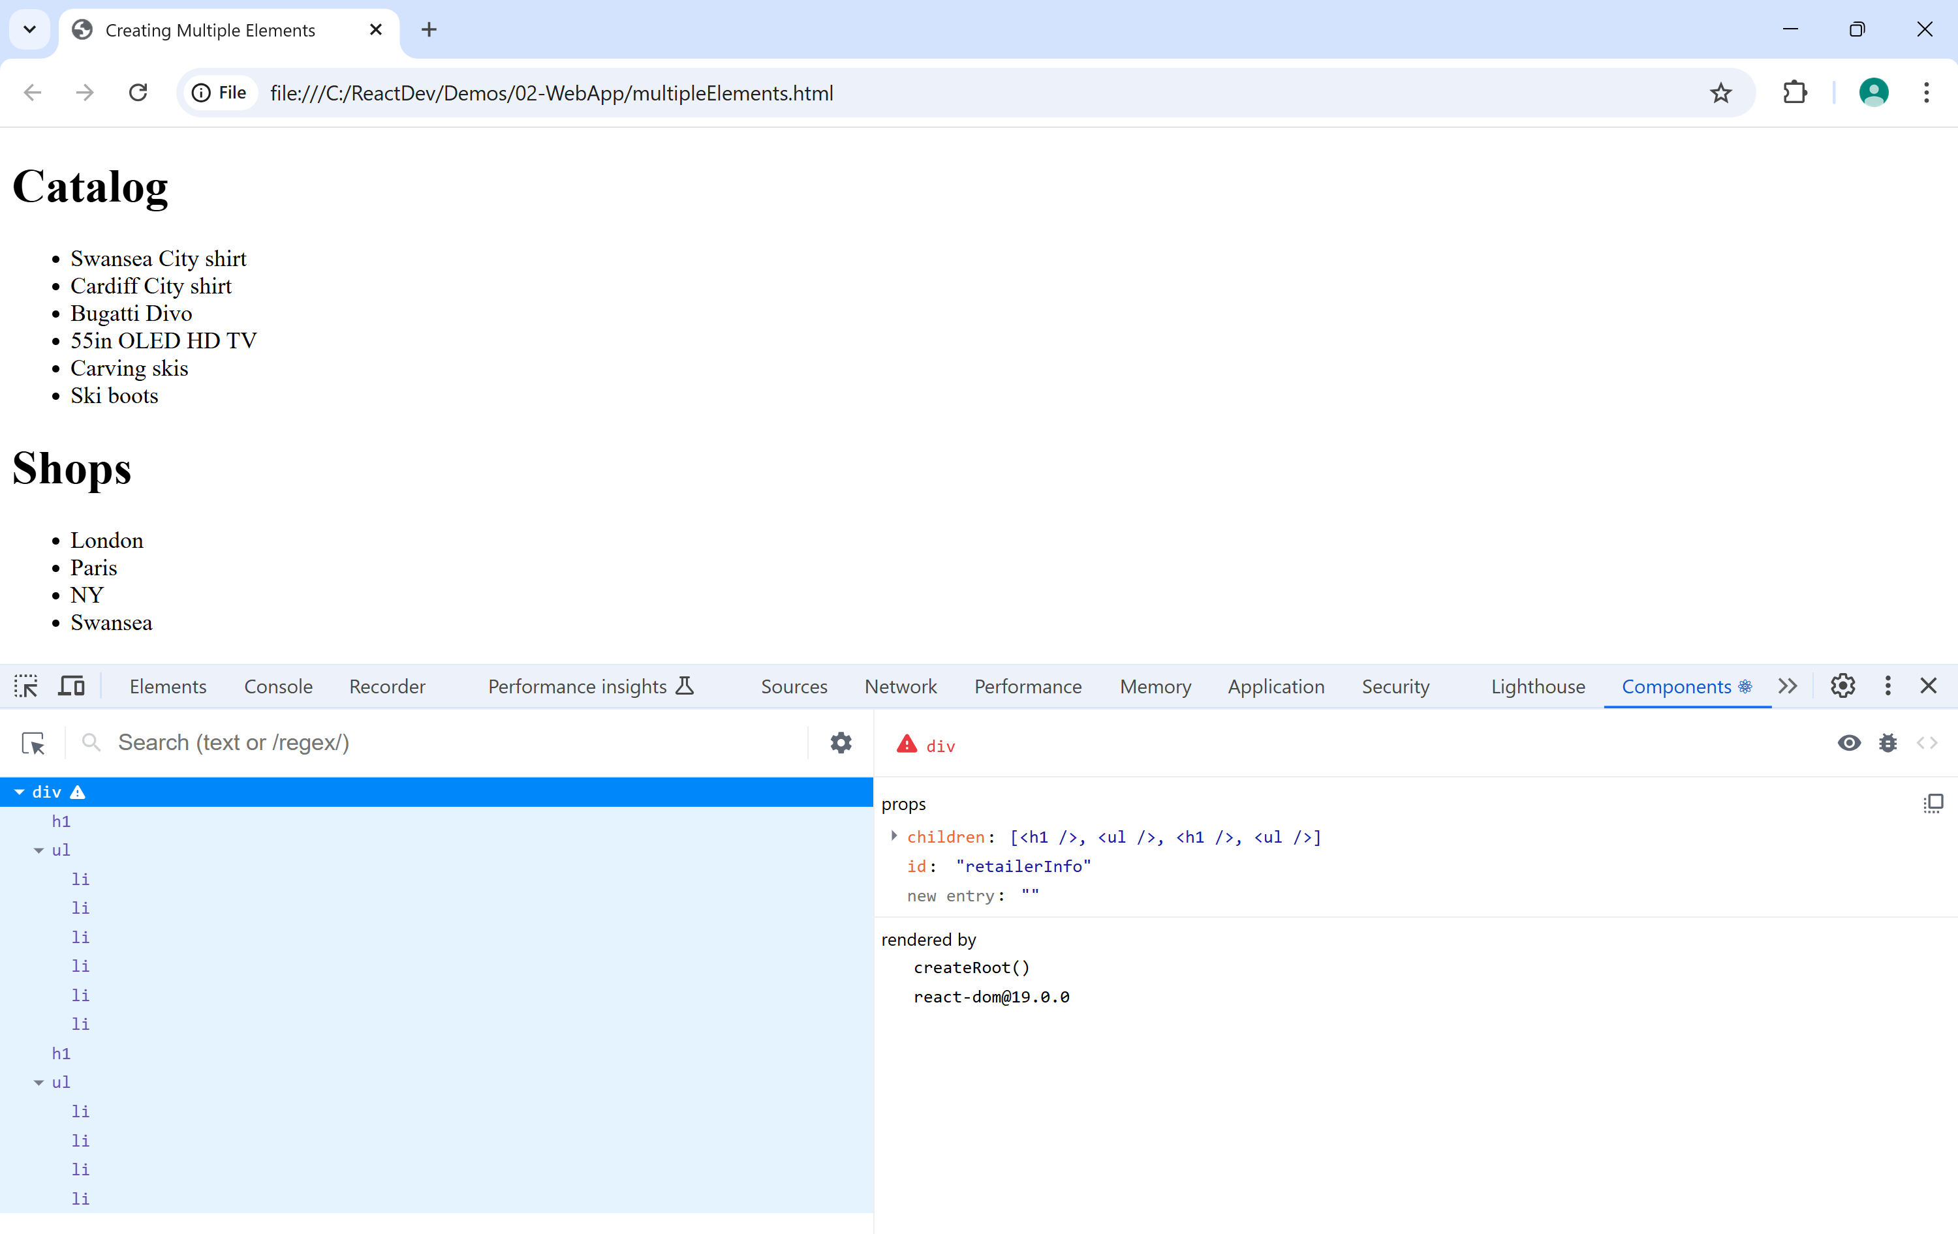
View the Virtual DOM (2 of 2)

Slide 16
Section 3: Data-Driven UIs
Overview
Defining data
Mapping data to elements
Example
View the page in the browser

Slide 17
Overview
The previous section created a hard-coded hierarchy of React elements
In a real app, you'll adopt a data-driven approach
The elements you create will depend on data
We'll see how to create a data-driven UI in this section
See multipleElementsViaData.html

Slide 18
Defining Data
We'll have an array of products and an array of shops
const products = [
'Swansea City shirt',
'Cardiff City shirt',
…
]
const shops = [
'London',
'Paris',
…
]

Slide 19
Mapping Data to Elements
You can use map() to map array item to React elem
map() takes a lambda parameter
The lambda receives 2 args - (array item, index)
The lambda creates and returns a React element
someArray.map((arrayItem, idx) => React.createElement(htmlElem,
htmlProps,
htmlContent)
)

Slide 20
Example (1 of 2)
Let's map products array into an <li> collection
Also map shops array into an <li> collection
const prodList = React.createElement(
'ul',
null,
products.map((p, i) => React.createElement('li', {key: i}, p))
)
const shopList = React.createElement(
'ul',
null,
shops.map((s, i) => React.createElement('li', {key: i}, s))
)

Slide 21
Example (2 of 2)
Now let's put it all together
const retailer = React.createElement('div', null,
React.createElement('h1', null, 'Catalog'),
prodList,
React.createElement('h1', null, 'Shops'),
shopList
)
const root = createRoot(document.getElementById('root'))
root.render(retailer)

Slide 22
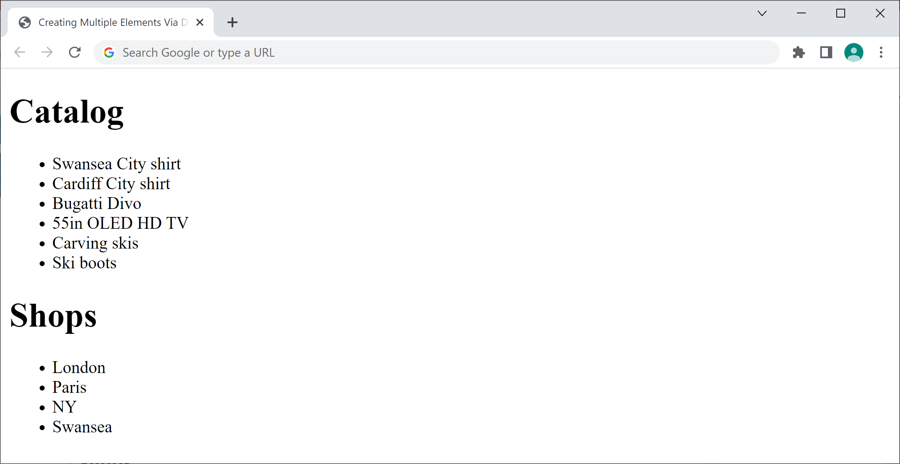
Viewing the Page in the Browser
Here's how the page looks in the browser

Slide 23
Summary
Creating a simple app
Creating many elements
Data-driven UIs

